Slide 1
DATA ANALYSIS OF UPI Transactions 2024
Data-Driven User Targeting and Profit Optimization

Slide 2
Business objective
Identify high-value user segments based on age, state, and transaction patterns.
Optimize profit by promoting high-margin transaction types like P2M and Bill Payments.
Enhance user engagement with personalized offers based on spending habits and timing.
Strengthen partnerships with top-performing banks and merchants to boost revenue.

Slide 3
Problem statement / Project scope
The dataset contains digital transaction details including user demographics, amount, location, banks, and timing.
There is no clear understanding of which user segments contribute most to value and engagement.
Without analyzing transaction types, merchant categories, and financial patterns, business opportunities remain hidden.
This project aims to explore behavior trends to identify profitable segments and guide strategic decision-making.

Slide 4
Solution approach
Extract only useful columns related to transaction behavior, user demographics, and financial entities for analysis.
Clean and preprocess the data using pandas for analysis.
Use Python libraries like matplotlib and seaborn for building relationships and visualizing patterns.
Analyze trends in transactions, demographics, and bank/merchant activity.

Slide 5
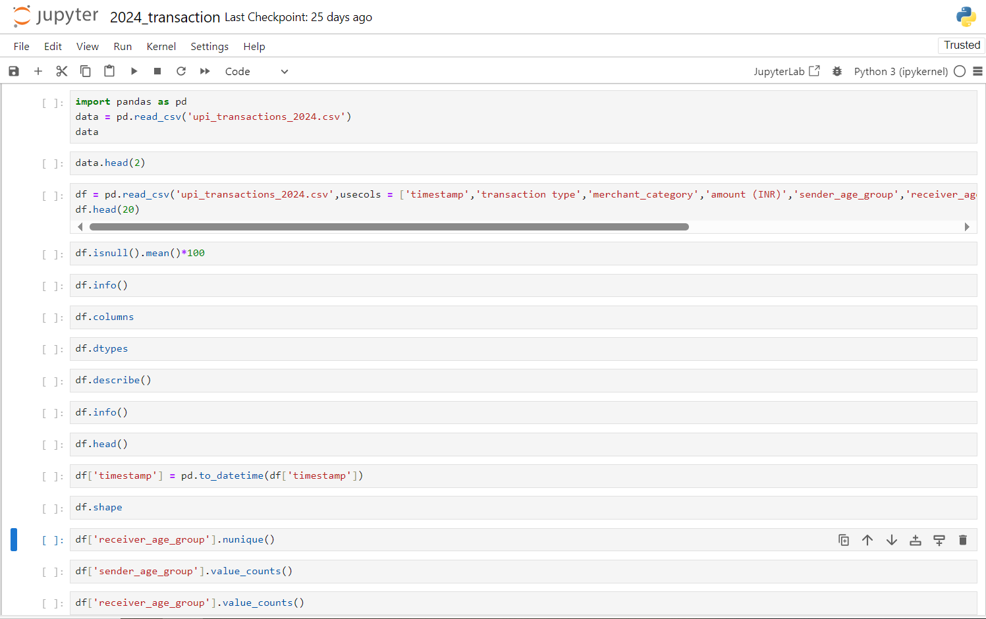
Data cleaning by pandas

Slide 6
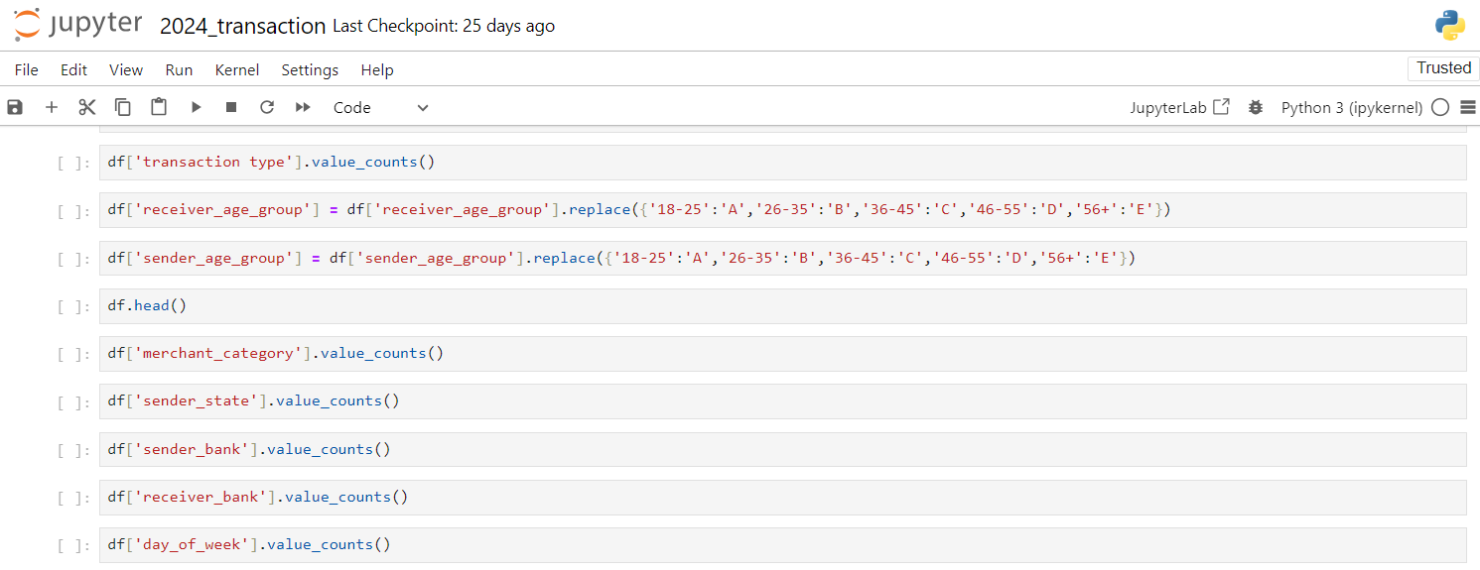
Data cleaning by pandas

Slide 7
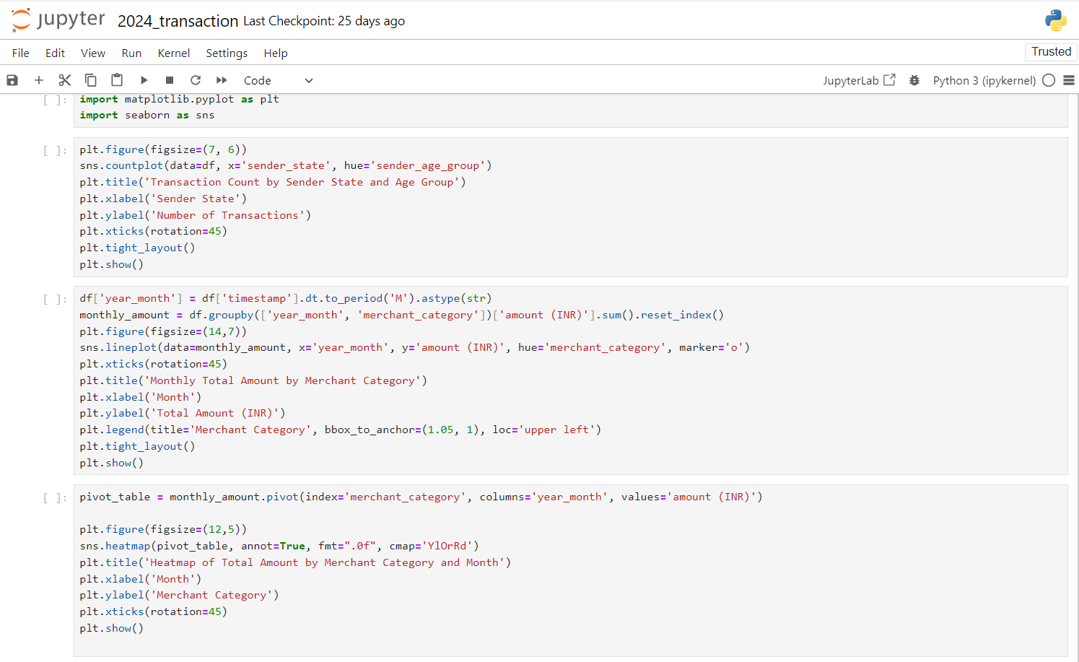
Data Visualization using Matplotlib and Seaborn

Slide 8
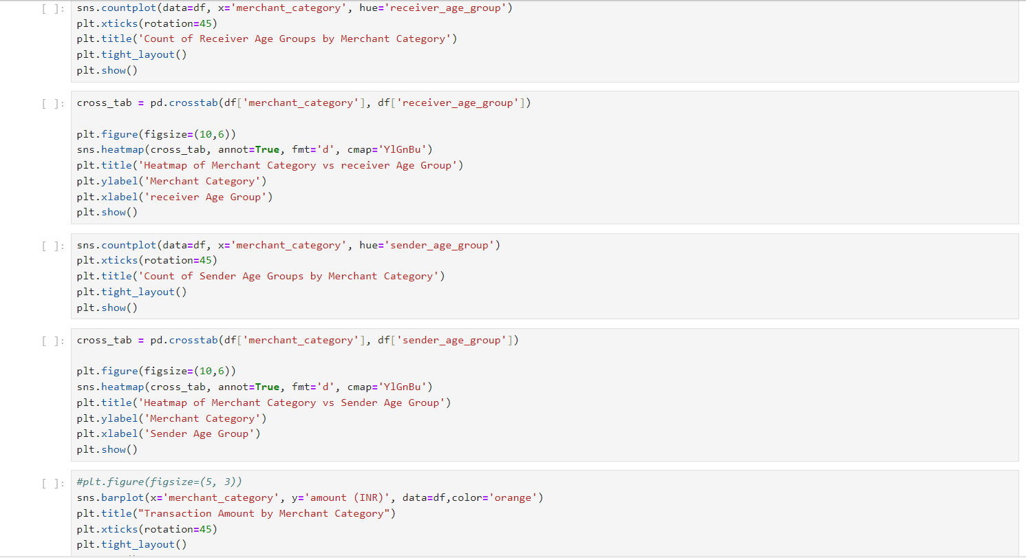
Data Visualization using Matplotlib and Seaborn

Slide 9
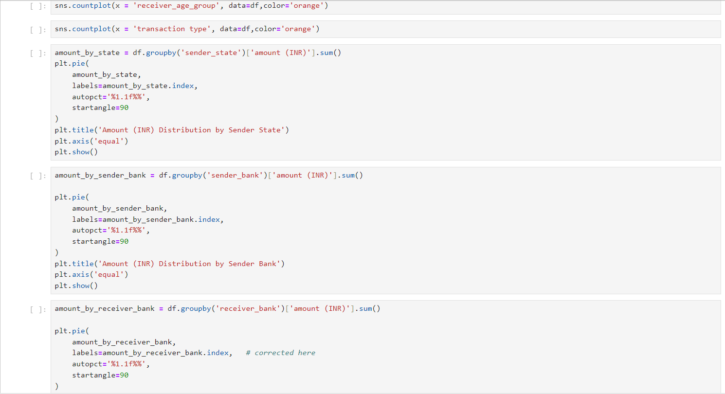
Data Visualization using Matplotlib and Seaborn

Slide 10
Solution approach
Columns Used for Data-Driven User Targeting and Profit Optimization :
Timestamp = The exact date and time when the transaction occurred
Transaction type = The nature of the transaction (e.g., credit, debit, transfer)
Merchant_category = The type of merchant or service category the transaction occurred
Amount (INR) = The value of the transaction in Indian Rupees
Sender_age_group = Age group of the person who initiated (sent) the transaction
Receiver_age_group = Age group of the person who received the transaction

Slide 11
Solution approach
Columns Used for Data-Driven User Targeting and Profit Optimization :
Sender_state = The Indian state where the sender is located
Sender_bank = The name of the bank the sender used for the transaction
Receiver_bank = The name of the bank where the amount was credited
Day_of_week = The day the transaction took place
Here Age groups mapped as '18-25': ‘A’, '26-35': ‘B’, '36-45': 'C’, '46-55': 'D’, '56+': 'E'

Slide 12
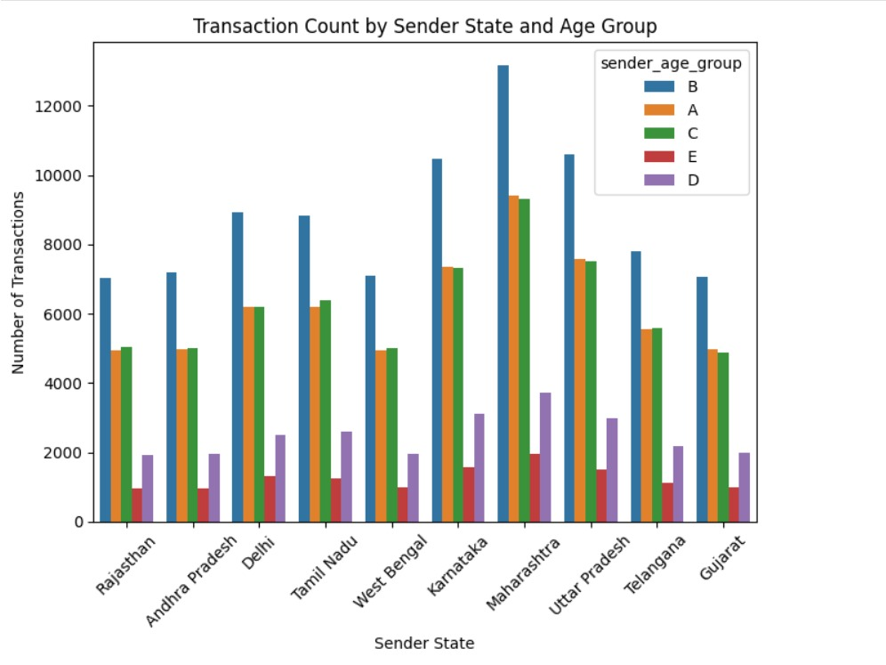
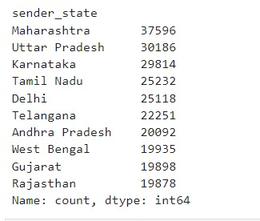
Transaction Count by Sender State and Age Group

Slide 13
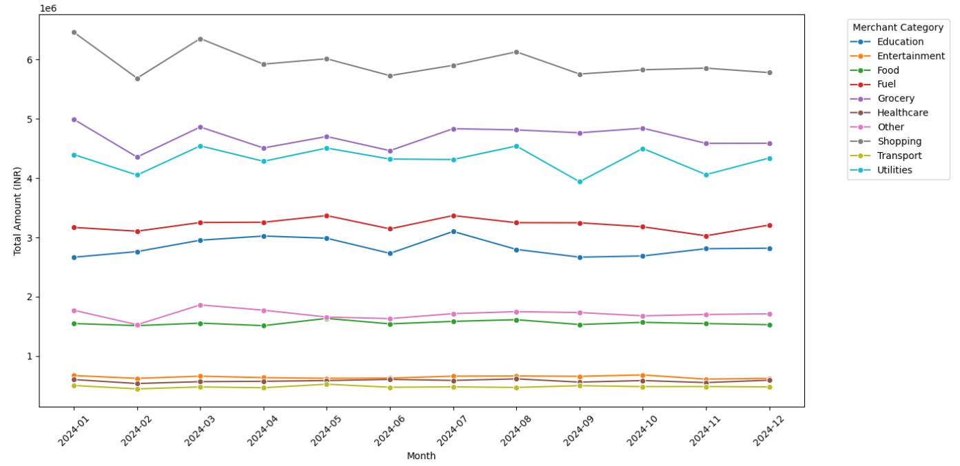
Monthly Total Amount by Merchant Category

Slide 14
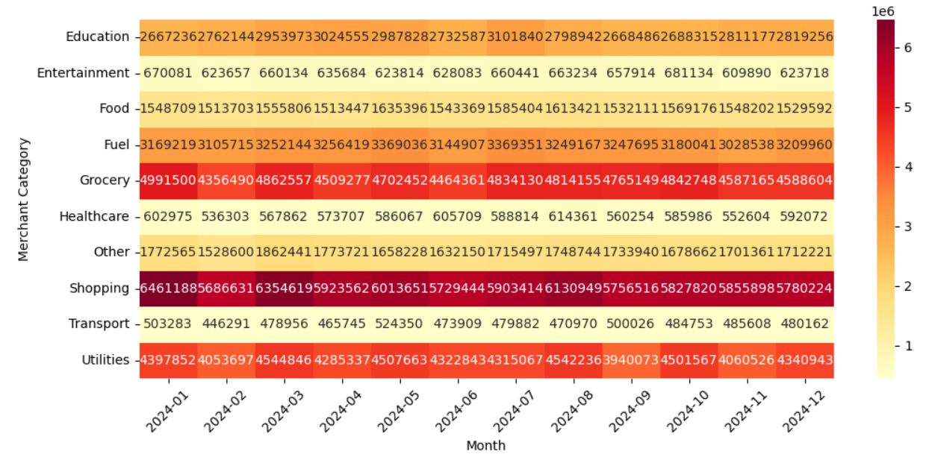
Heatmap of Total Amount by Merchant Category and Month

Slide 15
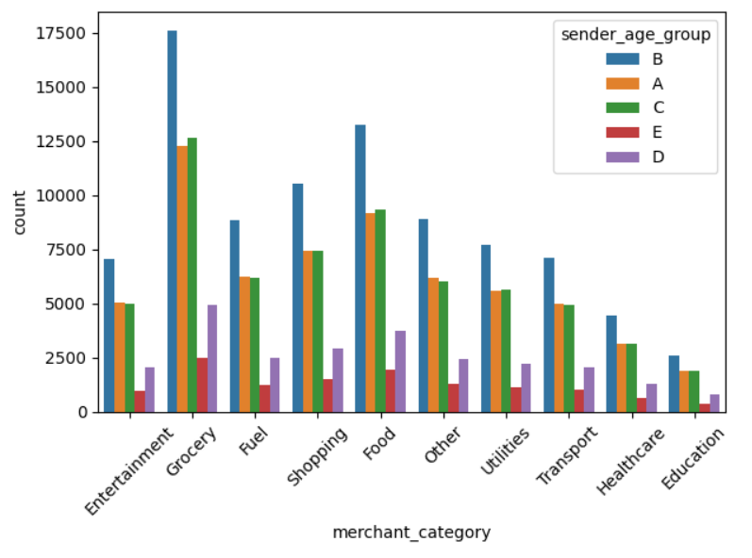
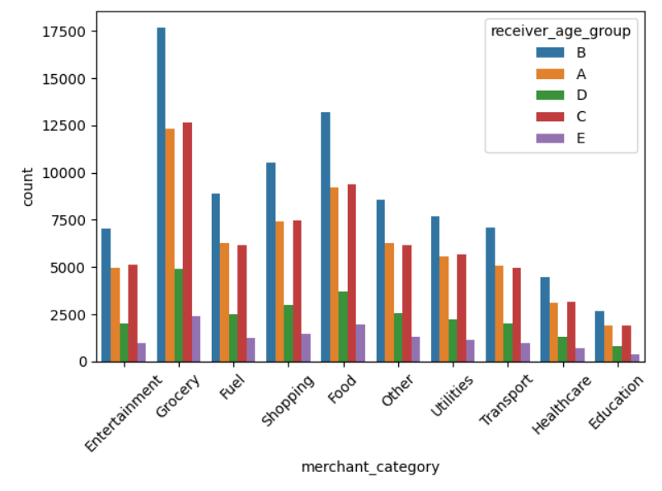
Count of Sender Age Groups by Merchant Category
Count of Receiver Age Groups by Merchant Category

Slide 16
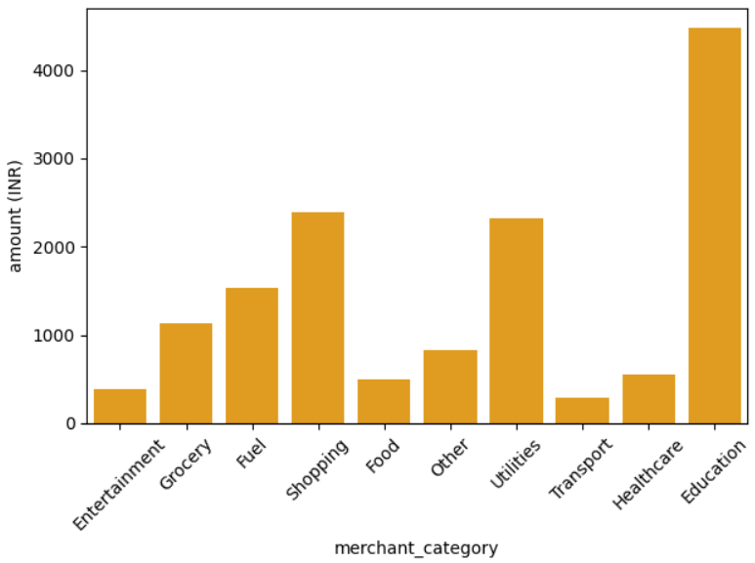
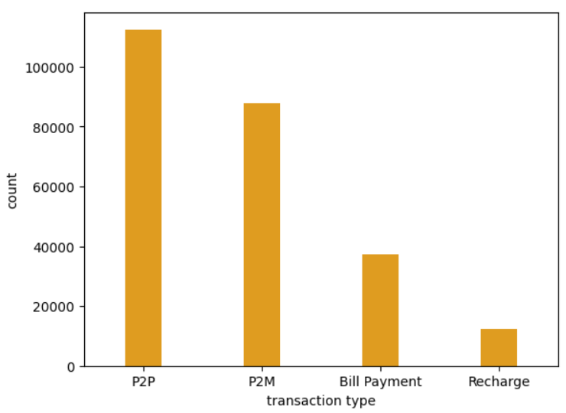
Transaction Amount by Merchant Category
Distribution of Transaction Types

Slide 17
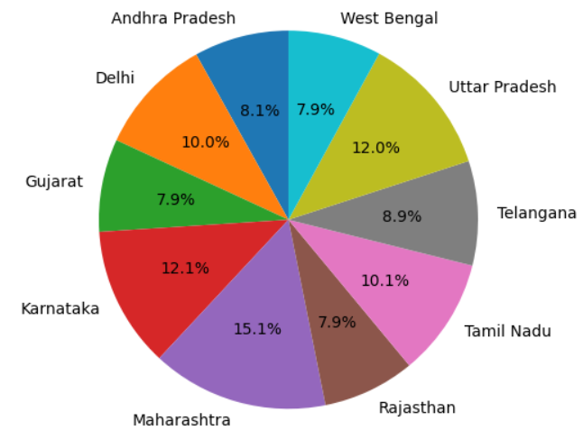
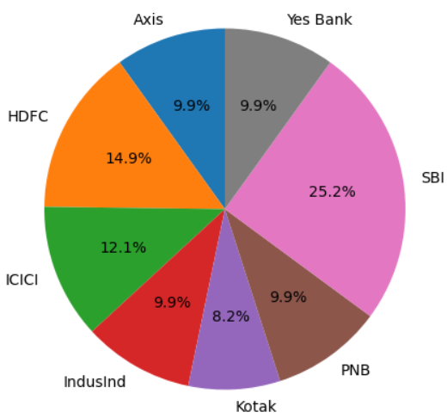
Amount (INR) Distribution by Sender State
Amount (INR) Distribution by Sender Bank

Slide 18
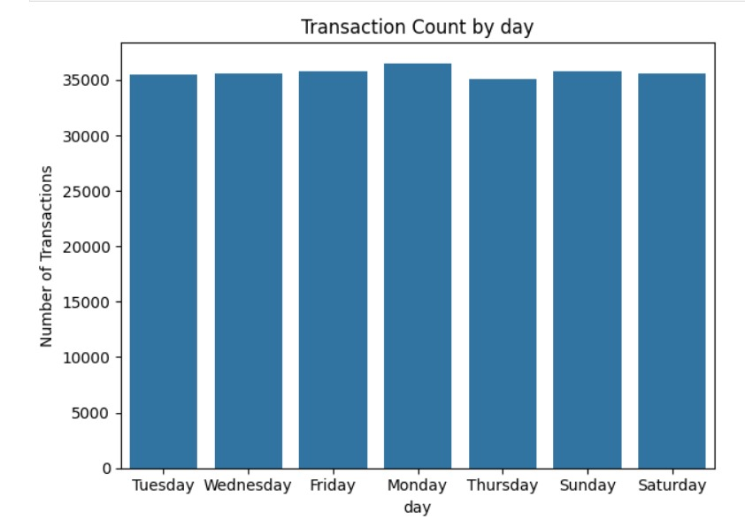
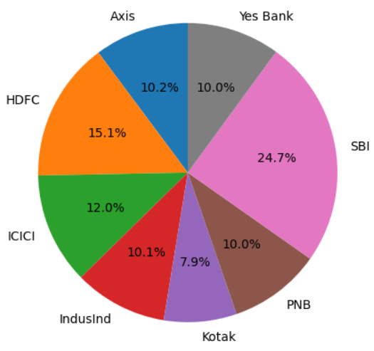
Amount (INR) Distribution by receiver bank
Transaction Count by day

Slide 19
Business outcomes
The following are some important business insights derived from the plots and charts:
Age group 'B' consistently drives the highest transaction volume across all major states, with Maharashtra recording the highest overall transactions, making both this demographic and state crucial for targeted financial and marketing strategies.
Shopping, Grocery, and Utilities emerged as the top 3 merchant categories in terms of total spending throughout the year, with the highest overall transaction amount recorded in January 2024 across most categories.
Education, Shopping, and Utilities drive the highest transaction amounts, indicating key sectors for revenue growth and targeted promotions.

Slide 20
Business outcomes
The following are some important business insights derived from the revenue dashboard:
P2P transactions dominate volume, suggesting strong user engagement and an opportunity to boost P2M and utility-based payments through incentives.
Maharashtra, Karnataka, and Uttar Pradesh contribute the highest transaction amounts, making them prime targets for regional campaigns and service expansion.
SBI (25.2%), HDFC (14.9%), and ICICI (12.1%) account for the highest transaction values, positioning them as top remitter banks for strategic collaborations and user-focused incentives

Slide 21
Conclusion
Maharashtra and age group 'B' lead in transaction volume, making them key targets for regional and demographic strategies.
Shopping, Grocery, Utilities, and Education are top spending categories, with peak transaction amounts in January 2024.
P2P dominates usage, but collaboration with SBI, HDFC, and ICICI can boost P2M and utility payments.

Slide 22
Thank you!

